Slide 1

Machine Learning Algorithms (Logistic Regression)
Md. Abu Naser Mojumder

Slide 2
Well known Machine Learning Algorithms
Supervised Learning
Unsupervised Learning
Reinforcement Learning
Regression
Simple Linear Regression
Multiple Linear Regression
Polynomial Regression
Clustering
K-Means Clustering
Hierarchical Clustering
Upper Confidence Bound(UCB)
Thomson Sampling
Classification
Logistic Regression
k-Nearest Neighbors(k-NN)
Support Vector Machine(SVM)
Naïve Bayes
Decision Tree Classification
Random Forest Classification
Dimensionality Reduction
Principal Component Analysis(PCA)
Linear Discriminant Analysis (LDA)
Deep Learning Algorithm
Artificial Neural Network(ANN)
Convolutional Neural Network(CNN)

Slide 3
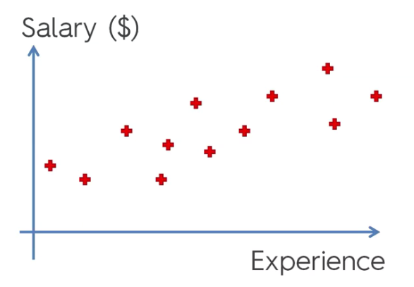
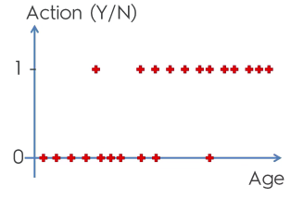
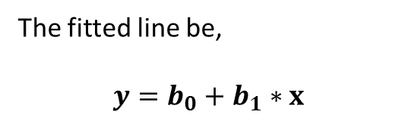
Logistic Regression
We already know how to deal with this type of challenge.
The fitted line be,
$$y=b_{0}+b_{1}∗x$$
But this is new:

Slide 4
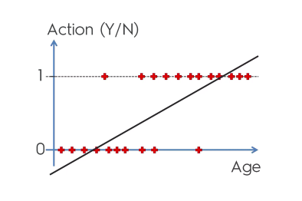
Logistic Regression
Lets consider, we need to classify persons according to their age.
The question is, “Are they suitable for a specific offer?”
This is a binary classification problem, we can’t fit like this:

Slide 5
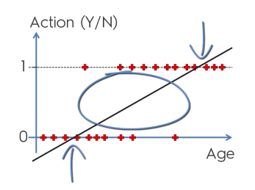
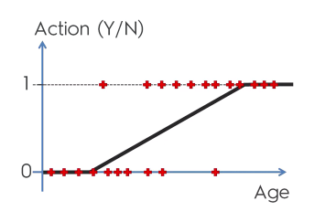
Logistic Regression
In a binary classification problem, the probability of a class has calculated. For our example the probability values are in between
0 and 1.
A certain age family is accepted this offer.
Let age > 5 to age < 55 is in between 0 and 1 probability. (fig. 1),
Now we need a function that fit these red point as much as possible and
Linear function does not work here surely.
We need such function that should fit like this(fig. 2):
Fig. 1
Fig. 2

Slide 6
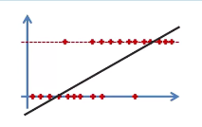
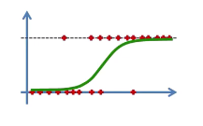
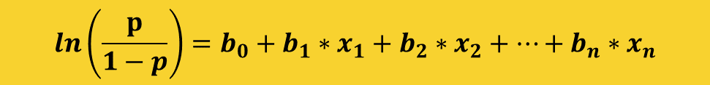
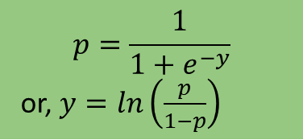


Logistic Regression
$$y=b_{0}+b_{1}∗x$$
$$p=\frac{1}{1+e^{−y}}$$
or, $y=ln⁡\left(\frac{p}{1−p}\right)$
Sigmoid Function
$$ln\left(\frac{p}{1−p}\right)=b_{0}+b_{1}∗x$$
The equation of Logistic Regression:
$$ln\left(\frac{p}{1−p}\right)=b_{0}+b_{1}∗x_{1}+b_{2}∗x_{2}+…+b_{n}∗x_{n}$$

Slide 7
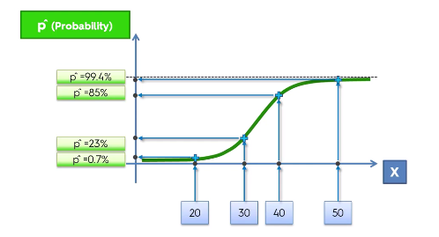
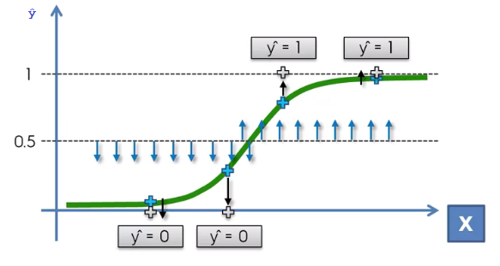
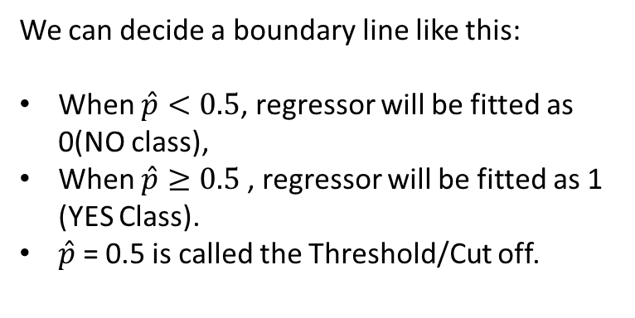
Logistic Regression
Here we have some observations:
Age | Probability
20 | 0.7%
30 | 23%
40 | 85%
50 | 99.4%
We can decide a boundary line like this:
When $\hat{p}<0.5$, regressor will be fitted as 0(NO class),
When $\hat{p}≥0.5$, regressor will be fitted as 1 (YES Class).
$\hat{p}$ = 0.5 is called the Threshold/Cut off.

Slide 8
Logistic Regression
Type of Logistic Regression:
On the basis of the categories, Logistic Regression can be classified into three types:
Binomial: In binomial Logistic regression, there can be only two possible types of the dependent variables, such as 0 or 1, Pass or Fail, etc.
Multinomial: In multinomial Logistic regression, there can be 3 or more possible unordered types of the dependent variable, such as "cat", "dogs", or "sheep”.
Ordinal: In ordinal Logistic regression, there can be 3 or more possible ordered types of dependent variables, such as “Low", "Medium", or "High".

Slide 9
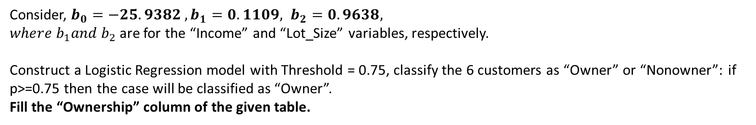
Logistic Regression
Review Questions
What is Feature Scaling?
Define Normalization and Standardization.
See the following Table and Answer the question:
Customer# | Income | Lot_Size | Ownership
1 | 60.0 | 18.4 | ?
2 | 64.8 | 21.6 | ?
3 | 84.0 | 17.6 | ?
4 | 59.4 | 16.0 | ?
5 | 108.0 | 17.6 | ?
6 | 75 | 19.6 | ?
Consider, $b_{0}=−25.9382 , b_{1}=0.1109, b_{2}=0.9638,$
$where b_{1}and b_{2}$are for the “Income” and “Lot_Size” variables, respectively.
Construct a Logistic Regression model with Threshold = 0.75, classify the 6 customers as “Owner” or “Nonowner”: if p>=0.75 then the case will be classified as “Owner”.
Fill the “Ownership” column of the given table.

